Slide 1

Faculty of Law - Going on
Exchange 25/26 & beyond
(Subject to the prevailing exchange policies of HKU, our Faculty and the partner universities from time to time)
Director of Exchange (outgoing)

Slide 2
Objectives of the Exchange Team
1. To enable you to experience law studies in other jurisdictions.
2. To facilitate transfer of approved courses into your degree as smoothly as possible.

Slide 3
What are the available Exchange Schemes at HKU?
1. HKU Worldwide Undergraduate Student Exchange Programme (HKUWW) managed by the International Affairs Office (IAO)
2. Law Faculty-based Exchange Programme
3. You may apply for both exchange programmes, but only one final offer will be given if you are shortlisted.
4. If you have any preference for the list of institution for both exchange programmes, please indicate to us during your application for the Faculty-level exchange programme.

Slide 4
Law Faculty-based Exchange Programme 1
1. Based on reciprocal bilateral exchange agreements
2. You pay HKU fees
3. You could graduate with your classmates
4. Not requiring a deferral of your studies because you may transfer the credits you earn at host university to your HKU degree

Slide 5
Law Faculty-based Exchange Programme 2
TWO programmes:
1. Law Faculty-based Exchange Programme (reciprocal bilateral exchange agreements)
2. Faculty of Law Visiting Student Programme (without exchange agreement)

Slide 6
*Visiting Student Programme (VSS)
1. To spend a year at top rank universities with which we do not have exchange agreement (includes 1 FY student for Hertford College, Oxford & 1-2 FY students for Caius College, Cambridge)
2. Other selected students may apply to other colleges e.g. St Catherine at Oxford or LSE on your own initiative
3. Shortlisted candidates may be invited for an interview.
4. Maximum number of students to be selected under VSS is currently set as 10

Slide 7
Application under the VSS
1. Using the same application form, you can put more than one choice on it
2. Selected students take one year leave of absence from HKU
3. Excused payment of HKU fees but pay host’s fees
4. Subject to approval of study plan, courses taken at approved hosts may be transferred into your HKU degree without delay in graduation

Slide 8
Eligibility for Law Exchange
LLB: 3rd or 4th year
Integrated degree: 4th or 5th year
Students with a CGPA of 3.3 or above have a relatively higher chance of getting a placement in the programme but students marginally miss the requirements may also be considered.

Slide 9
Securing The Best Exchange Options
We take both overall CGPA and Law CGPA into account.
We try to be fair between the different schools in allocating the very best places.
The best law students are usually keen and active readers of primary and secondary materials, active participants in class discussions.

Slide 10
Choosing hosts
1. ONLY put down places you are definitely willing to go. If you are given an offer for a host on your list (even No.5), you are expected to accept that offer. If there really are only 2 partners you will consider, just list those.
2. If you decline an offer, you will probably not get another offer, certainly not in the same year.
3. Please do not ask the Exchange Team to reconsider any allocation to be made.
4. You may withdraw an application at any time before accepting the offer.

Slide 11
Withdrawal of offer
1. If you withdraw after accepting an offer, your deposit will be forfeited unless the Exchange Team finds your reason for withdrawal convincing and your withdrawal is made as soon as possible.
2. Having a job or a concern about the grades are not good reasons.
3. Withdrawing may lead to a loss of exchange allocations and could impact the opportunities for other applicants, please thoughtfully consider and plan your exchange strategy.

Slide 12
Course Selection guidelines:
*Restructuring of courses
In order to keep as many free/discipline electives available for exchange, courses that would ordinarily be taken in year 3 should be taken in year 2 or 4; courses taken in year 4 should be taken in year 3 or other variations between year 4 & 5

Slide 13
Course Selection guidelines:
*Credit transfer 1
1. Take normal load of courses for one semester or one full year and will transfer 30 HKU or 60 HKU credits respectively.
2. Any over or under-loading must be approved in advance by the Exchange Team for exceptional cases.
3. Different hosts have different courses each semester and some have full year courses only, so you have to plan well ahead.
4. If the host institutions are under both Faculty-based and HKUWW Exchange Programmes, you will normally be allowed to take law courses under the Faculty-based Exchange Programme.

Slide 14
Course Selection guidelines:
*Credit transfer 2
1. You need to get prior approval for each law subject from the Exchange Team in order to transfer any law credits to your HKU degree.
2. For each compulsory non-law subject, you need to get prior approval from the relevant non-law department e.g. Department of PPA.

Slide 15
Course Selection guidelines:
*Credit transfer 3
1. You may refer to List of Approved and Not Approved Courses that transfer approved courses into your HKU degrees, including compulsory courses (accepted by the Exchange Team on the written advice of the subject teachers) OR PCLL pre-requisites (as approved by the HK Conversion Examination Board). More information from their website.
2. The table is for quick reference only and it is updated regularly. The course selection is subject to the approval of the host institution. Students are reminded to periodically review the course requirements and available courses offered by the host.

Slide 16
Course Selection guidelines:
*Credit transfer 3
3. Compulsory courses (law & non-law) transfer for the same number of credits as the equivalent HKU courses.
4. The remaining credits transfer as free/ discipline elective credits, irrespective of the number of elective courses taken at the host university.

Slide 17
Course Selection guidelines:
*PCLL pre-requisites
You should study most PCLL pre-requisites at HKU
Exceptions:
1. the law at host is substantially the same as in HK
2. you have an opportunity to learn from an exceptional professor
3. your degree structure requires you to take some PCLL pre-requisites on exchange
4. you have no intention to enter PCLL ever

Slide 18
Course Selection guidelines:
*True Law Elective Rule
1. Take at least ONE (1) course per semester (or one full year course for full-year exchange) as approved by the Exchange Team which is a true law elective i.e. NOT a required course for LLB or PCLL and not a non-law elective (equivalent to at least 6 HKU law credits).
2. Compulsory introductory courses on the host's legal system are NOT counted!
3. If you are on HKUWW exchange and the host are not offering law courses, you can be exempted from the true law elective rule but you have to take at least one free elective course instead.

Slide 19
Preparing Study Plan:
*When to submit exchange study plan
1. Submit your study plan and obtain leave of absence at least 2-3 weeks before departure (submit the application for leave of absence first IF you have not yet finalised your course selection/obtained approval for study plan.)
2. Ensure all your courses have been approved by the hosts and the Exchange Team

Slide 20

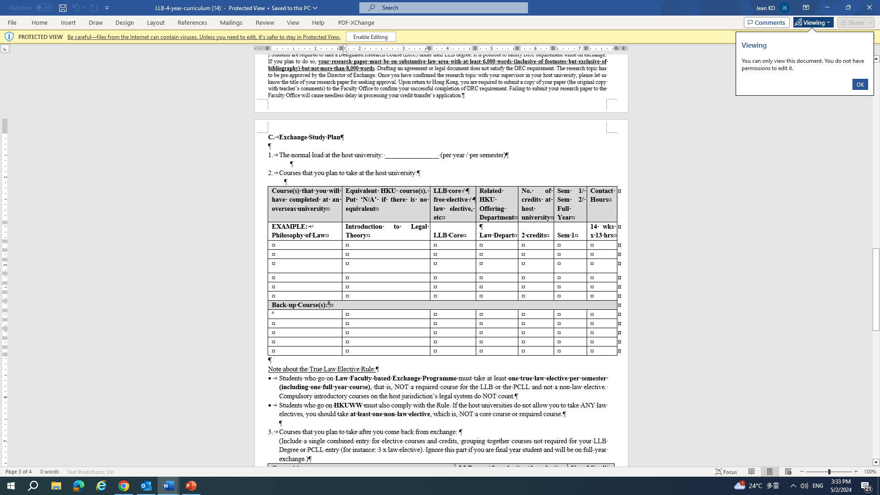
Preparing Study Plan
You may download exchange study plan at https://www.law.hku.hk/current-students/outgoing-exchange-programme-application-forms/
Please fill in info:
normal load at host
course code/name at host
equivalent HKU course
Law elective/free elective
Related HKU offering department ……etc

Slide 21
Preparing Study Plan:
*Transfer of courses
1. Law electives & LLB core courses that are not PCLL equivalents (transferrable only with the prior approval of the Exchange Team)
2. PCLL pre-requisites (prior approval of the HK Conversion Examination Board). Please submit your application to the Board by the stipulated deadline(s) i.e. end of Feb or end of Aug 2024. Please refer to their website for updated information.
3. Non-law subjects (transferrable only with the Exchange Team’s prior approval)

Slide 22
Preparing Study Plan:
*Approval for LLB Core
1. Check our website for a list of approved/disapproved courses (updated regularly). Students are reminded that the list is for reference only. Although the courses have been reviewed and approved by the HKU course teachers, the final approval of the subject enrollments is always subject to the hosts’ discretion.
2. If the course is NOT on the list, you should obtain the opinion of relevant HKU subject teacher and forward the opinion to the Exchange Team at lawexchange@hku.hk together with your application.
3. Your application include course description, unit or credit weighting, contact hours, assessment method, etc.

Slide 23
Preparing Study Plan:
*Approval for PCLL pre-requisites
1. Admission to PCLL requires you to complete the 9 core subjects eg. BA, Land Law, Evidence... and 3 top-up subjects i.e. Constitutional Law, HK legal system and Land Law. The top-up subjects must be done in HK
2. For core subjects, you can take those at HKU or, with the express prior approval of the PCLL Conversion Board, at host while on exchange
3. If a course has not been approved by the Conversion Examination Board, then you need to make your application to them

Slide 24
Preparing Study Plan:
*For Illustration only
1. Assuming a LLB student going on exchange at the University of Queensland, Australia during the 2nd semester in Year 3
2. Student proposes to take 4 courses @2 units = 8 units (normal load at U of Queensland)
3. 4 courses: (1) Corporate Law, (2) Evidence, (3) Law & Technology & (4) Psychology & Law
4. Exchange Team approved to transfer 30 credits back to HKU: 6 Business Associations (approved by Conversion Board) + 6 Evidence (approved by Conversion Board) + 18 law (free) electives.

Slide 25
Brief Note For Integrated Degree Students
1. Decide whether you wish to do a BSS, BBA, BSc or BA exchange OR a law exchange. It is not possible to do both.
2. If you wish to do a BSS, BBA, BSc or BA exchange, you may only transfer a maximum of 12 HKU law credits, possibly less – at the discretion of the Exchange Team. Apply through your other faculty in the usual way, making your wish to study some law very clear and giving full details and your other faculty will liaise with us.

Slide 26
Integrated Degree – continued 1
3. Exchange is a privilege and a great opportunity. It does not come free. You may need to use some or all of your 72 credit/year overload allowance in earlier years to clear away sufficient space for exchange, certainly for a full year exchange.
4. Your object should be to try to have as many law elective and free elective credits available for exchange as is possible. Even so, you may end up earning more law elective credits than you strictly need to graduate – an education bonus, not a problem.

Slide 27
Integrated Degrees – continued 2
5. Conversely, you should try to clear away as many compulsory/ PCLL prerequisites as possible – to maximize your exchange options.

Slide 28

Sharing session
By students who have previously participated in an exchange or visiting programme.

Slide 29
Frequently Asked Questions (FAQ)
What is the assessment criteria?
Applicants will be assessed based on their academic performance (e.g. CGPA and LawGPA), personal statement and other related factors etc. Each cohort will be ranked separately. The decision will be made with the object of achieving a fair distribution between the different programmes.
If I rejected the offer in first round, am I still eligible to apply for the second-round law faculty exchange application?
If you are given an offer for a host on your list, you are expected to accept that offer, even if it is the 5th option on your list. If you decline an offer for a host on your list, you will probably not get another offer in the same year.
Will I be allowed to transfer law credits under HKUWW exchange programmes?
Some institutions under HKUWW do not offer law subjects to exchange students. If you wish to study law subjects under HKUWW, you need to check with IAO and the host carefully. Also, if the host institutions are under both Faculty-level and HKUWW exchange programmes, you will normally be allowed to take law courses under the Faculty-level exchange programme.

Slide 30
Frequently Asked Questions (FAQ) (Con’t)
Do I need to seek approval for course mapping of law elective taken at host?
For law elective: No need to map between law elective at host and at HKU. If you have taken approved law courses at host, the credits transferred will be as law elective.
Regarding my exchange studies, do I need to pay for tuition fee at host?
With exchange agreement, students only need to pay HKU tuition fees. However, students will have to bear their own costs including insurance, food and accommodation etc. From our understanding, insurance is often a compulsory cost for overseas universities but each university varies. You may check with host university directly.
How do I apply for “Certificate of Completion” of PCLL prerequisite for exchange?
You need to complete the application form for “Certificate of Completion” of PCLL prerequisite and return it to the Exchange Team for processing.

Slide 31


