Slide 1
Faculty-based Outgoing Exchange Programme and Visiting Student Scheme (VSS) 2026/27 & Beyond
Ms. Xin Fang
Director of Exchange (Outgoing)
Subject to the prevailing exchange policies of HKU, the Faculty of Law and the partner institutions from time to time

Slide 2
Role of the Faculty of Law Exchange Team
To enable students to experience law studies in other countries and legal systems
To ensure the smooth transfer of approved courses into the degree programme

Slide 3
HKU Exchange Programmes
HKU Worldwide Undergraduate Student Exchange Programme (HKUWW) managed by the International Affairs Office (IAO)
Law Faculty-based Exchange Programme
You may apply for both exchange programmes; however, if shortlisted, only one final offer will be made
If you have preferences regarding the list of institutions for both exchange programmes, please indicate them when submitting your application for the Faculty-based Exchange Programme

Slide 4

Faculty of Law Programmes
Two Programmes
Law Faculty-based Exchange Programme (reciprocal bilateral exchange agreements)
Faculty of Law
Visiting Student Scheme (VSS) (without exchange agreement)

Slide 5
Law Faculty-based Exchange Programme
Established under reciprocal bilateral exchange agreements
HKU tuition fees apply
Graduate together with your cohort
With careful planning, do not require a deferral as credits earned at the host university can be transferred to your HKU degree

Slide 6
Faculty of Law Visiting Student Scheme (VSS)
Spend a year at top-ranked institutions where no Faculty-based exchange agreement exists (normally one to two full-year student at Hertford College, University of Oxford , and one to two full-year student(s) at Gonville and Caius College, University of Cambridge)
Other selected students may apply to colleges such as St Catherine's College, University of Oxford (normally around 6 full-year students)
Selected candidates may be invited for an interview
The maximum number of students to be selected under VSS is currently set at 10

Slide 7
Application under the VSS
Use the VSS application form (this is different from the Faculty-based Exchange Programme application form)
Applications open: 19 November 2025; Applications close: 2 January 2026
Exempt from HKU tuition fees; host institution fees apply
Subject to approval of the study plan, courses taken at approved host institutions may be transferred to your HKU degree, avoiding delays in graduation

Slide 8
Timeline for Faculty-based Exchange and Visiting Student Scheme (VSS) 2026-27
Year | Date | Activity | Details
Main Round Application (Full Year, Semester 1, and Semester 2)
2025 | 19 Nov (Wed) | Application opens | Faculty-based Exchange and VSS – Online application
 | 19 Nov (Wed) | Resources | Faculty-based Exchange and VSS – Information session
2026 | 2 Jan (Fri), 9am | Deadline | VSS – Online application
 | Mid-Jan | Interview | VSS – Shortlisted candidates
 | Mid-Jan | Result Release | VSS – Placement results
 | 23 Jan (Fri), 12nn | Deadline | Faculty-based Exchange – Online application
 | 6 Feb (Fri) | Result Release | Faculty-based Exchange – Placement results
 | 13 Feb (Fri) | Deadline | VSS and Faculty-based Exchange – Acceptance and deposit payment
Second Round Application (Full Year, Semester 1, and Semester 2)
2026 | April | Application opens | Faculty-based Exchange – Online application (subject to the number of places left from the main round)
 | April | Deadline | Faculty-based Exchange – Online application

Slide 9
Eligibility for Law Exchange Programmes
LLB Programme: 3rd or 4th Year
Integrated Double-degree Programmes: 4th or 5th Year
Students with a cGPA of 3.3 or above generally have a higher chance of securing a place in the programme; however, students who narrowly miss this requirement may also be considered

Slide 10
Securing The Best Exchange Options
We take both the overall cGPA and the Law cGPA into account.
We strive to ensure fairness across different programmes when allocating the best places.

Slide 11
Choosing Hosts – Read Carefully
ONLY list places you are absolutely willing to go. If you receive an offer for any host institution on your list (even your No.5 choice), you are expected to accept it. If you would only consider two institutions, then list only those.
If you decline an offer, you will likely not receive another one, and certainly not within the same year.
Please do not ask the Faculty of Law Exchange Team to reconsider any allocation once it has been made.
You may withdraw your application at any time before accepting an offer.

Slide 12
Withdrawal of Offer
If you withdraw after accepting an offer, your deposit will be forfeited unless the Faculty of Law Exchange Team finds your reason for withdrawal convincing and you notify us as soon as possible.
Having a job or concerns about grades are not considered valid reasons.
Withdrawing may result in the loss of exchange allocations and could affect the opportunities for other applicants. Please plan your exchange strategy thoughtfully before committing..

Slide 13
Course Selection Guidelines
Restructuring of courses
To maximize the availability of free / discipline electives for exchange:
LLB students should take courses normally planned for Year 3 in Year 2 or Year 4.
Integrated double-degree students should take courses normally planned for Year 4 in Year 3, or other variations between Years 4 and 5.

Slide 14
Course Selection Guidelines
Credit transfer (1)
Take a normal course load for one semester or a full academic year, which will result in the transfer of 30 HKU or 60 HKU credits, respectively.
Any overloading or underloading shall require prior approval from the Faculty of Law Exchange Team and will only be permitted in for exceptional circumstances.
Different host institutions offer different courses each semester, and some institutions offer full-year courses only. Students shall plan well in advance.
If a host institution is under both Faculty-based and HKUWW Exchange Programmes, students shall normally be allowed to take law courses under the Faculty-based Exchange Programme only.

Slide 15
Course Selection Guidelines
Credit transfer (2)
Students shall obtain prior approval from the Faculty of Law Exchange Team for each law subject in order to transfer any law credits to their HKU degree.
For each compulsory non-law subject, students shall obtain prior approval from the relevant non-law faculty or department first, and then from the Faculty of Law Exchange Team. The Application for Credit Transfer form available on the Faculty’s website shall be used to seek formal approval from the HKU course-offering faculty or department concerned.

Slide 16
Course Selection Guidelines
Credit transfer (3)
Students may refer to the List of Approved and Not Approved Courses for guidance on approved courses eligible for transfer to HKU degrees, including compulsory courses (accepted by the Faculty of Law Exchange Team on the written advice of the subject teachers) OR PCLL prerequisites (as approved by the PCLL Conversion Examination Board). Further details are available on the relevant website.
The List is provided for quick reference only and is updated regularly. Course selection is subject to the approval of the host institution. Students are reminded to periodically review course requirements and the courses offered by the host institution.

Slide 17
Course Selection Guidelines
Credit transfer (3) (continues)
Students shall note that the host institution may not allow students to take all desired courses; flexibility in course selection is required.
Compulsory courses (law & non-law) shall transfer for the same number of credits as the equivalent HKU courses.
Remaining credits shall transfer as free/ discipline elective credits, irrespective of the number of elective courses taken at the host institution.

Slide 18
Course Selection Guidelines
PCLL prerequisites
Students should study most PCLL prerequisites at HKU.
Exceptions may apply under the following circumstances:
The law of the host jurisdiction is substantially the same as that in Hong Kong
The student has an opportunity to learn from an exceptional professor.
The student has no intention of entering the PCLL programme.
The student’s degree structure requires him/her to take some PCLL prerequisites during exchange.

Slide 19
Course Selection Guidelines
True Law Elective Rule
Students shall take at least ONE (1) course per semester (or one full-year course for a full-year exchange) that is a true law elective, as approved by the Faculty of Law Exchange Team. A true law elective refers to a course that is NOT a required course for the LLB or PCLL and is not a non-law elective (equivalent to at least six (6) HKU law credits).
Compulsory introductory courses on the host jurisdiction's legal system are NOT counted as true law electives.
Students participating in HKUWW exchange where the host institution does not offer law courses can be exempted from the True Law Elective Rule; however, they need to take at least one free elective course instead.

Slide 20
Study Plan Preparation
When to submit exchange study plan
Students shall submit their study plan and obtain approval of leave of absence at least four (4) weeks prior to departure. If course selection has not yet been finalised / study plan approval has not yet been obtained, the application for leave of absence shall be submitted first.
Students shall ensure that all courses have been approved by both the host institution and the Faculty of Law Exchange Team.

Slide 21
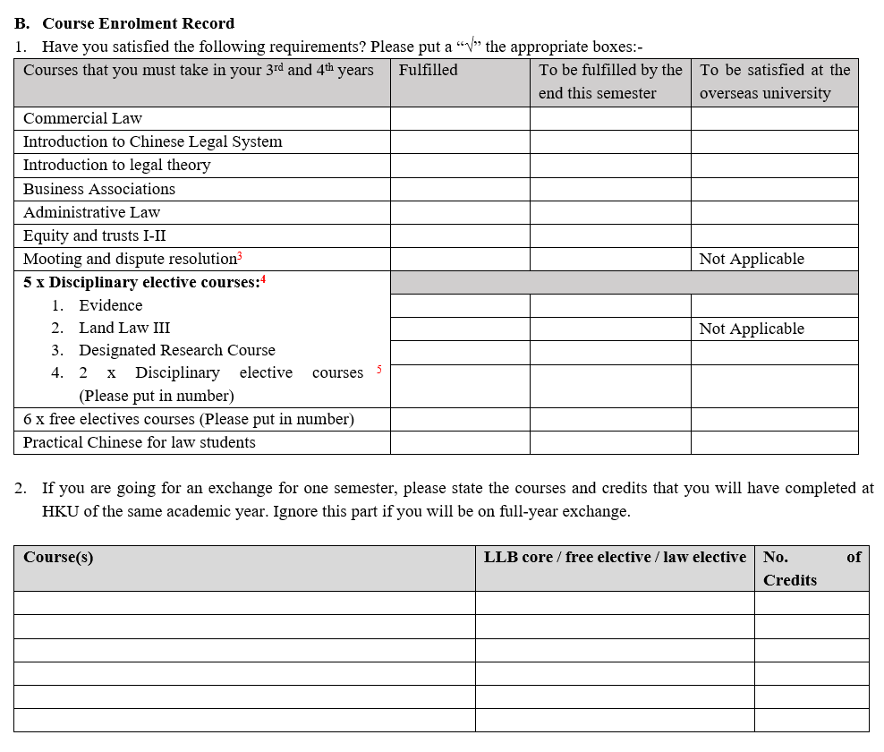
Study plan can be downloaded at Faculty’s Outgoing Exchange Programme website
Study Plan Preparation
Exchange study plan template
Please fill in information such as:
Normal load at host institution
Course code/name at host institution
Equivalent HKU course
Law elective / free elective
Related HKU offering faculty / department

Slide 22
Study Plan Preparation
Transfer of courses
Law electives and LLB core courses that are not PCLL equivalents can be transferrable only with the prior approval of the Faculty of Law Exchange Team.
PCLL prerequisites require prior approval from the PCLL Conversion Examination Board. Students shall submit their application to the Board by the stipulated deadline(s), namely end of February or end of August every year. Students should refer to the Board’s website for updated information.
Non-law subjects can be transferrable only with the prior approval of the Faculty of Law Exchange Team.

Slide 23
Study Plan Preparation
Approval for LLB core
Students shall check the Faculty website for the list of approved / not approved courses, which is updated regularly. The list is for reference only. Although courses have been reviewed and approved by HKU course teachers, final approval of subject enrollment rests with the host institution.
If a course is NOT on the list, students should obtain the opinion of relevant HKU subject teacher and forward the opinion to the Faculty of Law Exchange Team at lawexchange@hku.hk together with the application.
Applications shall include the course description, unit or credit weighting, contact hours, assessment method, etc.

Slide 24
Study Plan Preparation
Approval for PCLL prerequisites
Admission to the PCLL requires completion of nine (9) core subjects (e.g., Business Associations, Land Law, Evidence) and three (3) top-up subjects, namely Constitutional Law, Hong Kong legal system, and Hong Kong Land Law. The top-up subjects must be completed in Hong Kong.
Core subjects can be taken at HKU or, with the express prior approval of the PCLL Conversion Examination Board, at the host institution during exchange.
If a course has not been approved by the PCLL Conversion Examination Board in advance, students need to submit an application to the Board.

Slide 25
Study Plan Preparation
Example for demonstration only
Assuming an LLB student undertakes exchange at the University of Queensland, Australia, during the 2nd semester in Year 3.
Study Plan:
Student proposes to take 4 courses, each carrying 2 units, for a total of 8 units (normal load at the host institution)
The 4 courses are: (1) Corporate Law, (2) Evidence, (3) Law & Technology and (4) Psychology & Law
The Faculty of Law Exchange Team approves the transfer of 30 credits back to HKU: 6 credits for Business Associations (approved by PCLL Conversion Examination Board) + 6 credits for Evidence (approved by PCLL Conversion Examination Board) + 18 credits for law (free) electives.

Slide 26
Brief Note for Integrated Double-degree Programme Students
Students shall decide whether to undertake a BA, BBA, BSc or BSocSc exchange, OR a law exchange. It is not possible to do both.
Students opting for a BA, BBA, BSc or BSocSc exchange may only transfer a maximum of twelve (12) HKU law credits, and possibly fewer, at the discretion of the Faculty of Law Exchange Team. Applications shall be submitted through the relevant faculty / department in the usual manner, clearly indicating the intention to study some law and providing full details. The faculty / department concerned will liaise with the Faculty of Law Exchange Team.

Slide 27
Brief Note for Integrated Double-degree Programme Students (continues)
Exchange is a privilege and an important academic opportunity. It does not come without a cost. Students may need to use some or all of their overload allowance of 72 credits per year in earlier years to create sufficient space for exchange, particularly for a full-year exchange.
Students should aim to have as many law elective and free elective credits available for exchange as is possible. Even with careful planning, students may end up earning more law elective credits than strictly required for graduation. This shall be regarded as an educational benefit rather than a concern.
Conversely, students should try to clear away as many compulsory / PCLL prerequisites as possible in order to maximize their exchange options.

Slide 28








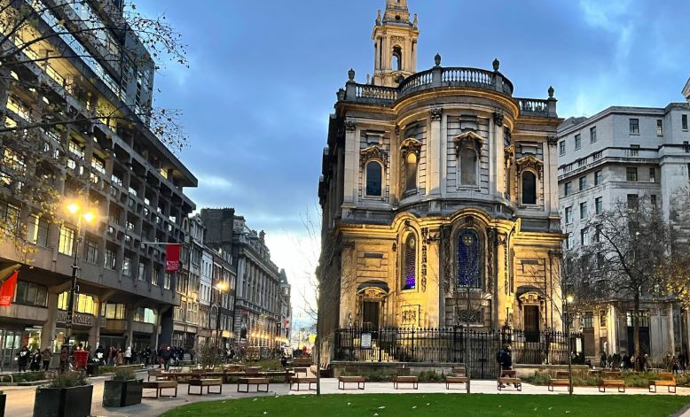
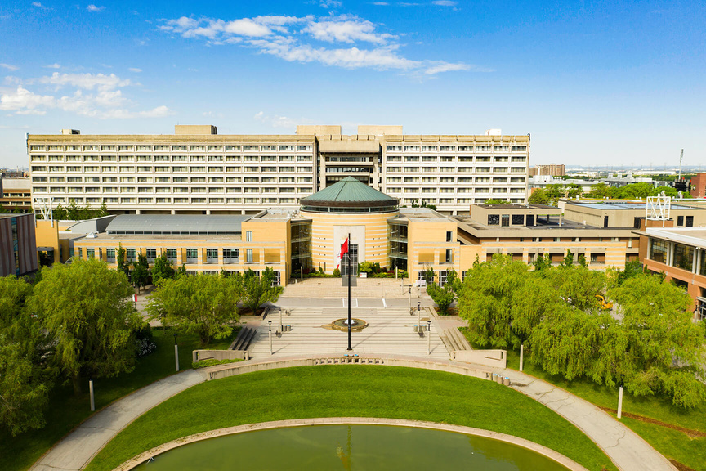
Student Sharing
Fiona Zhang
LLB
Lance Hu
BBA(Law)&LLB
Charmaine Wong
BA&LLB
Rae Chiu
BSocSc(Govt&Laws)&LLB
St. Catherine’s College,
University of Oxford
University of Pennsylvania
King's College London
York University
Full-year
Semester 1
Semester 1
Full-year

Slide 29
Frequently Asked Questions (FAQ) for Faculty-based Exchange Programme
Q. What is the evaluation criteria?
Applicants will be evaluated based on their academic performance (e.g., cGPA and LawGPA), personal statement, and other related factors. Each cohort will be ranked separately. Decisions will be made with the objective of ensuring a fair distribution across the different programmes.
Q. If I reject the offer in the first round, am I still eligible to apply for the second-round Faculty-based Exchange Programme?
If you receive an offer for a host institution on your list, you are expected to accept it, even if it is the 5th choice on your list. If you decline any offer for a host institution on your list, you will likely not receive another offer in the same academic year.
Q. Will I be allowed to transfer law credits under HKUWW exchange programmes?
Some institutions under HKUWW do not offer law courses to exchange students. If you wish to take law courses under HKUWW, you must check carefully with both the International Affairs Office (IAO) and the host institution, and obtain prior approval from the Faculty of Law Exchange Team. Additionally, if a host institution is available under both Faculty-based and HKUWW exchange programmes, you will normally be allowed to take law courses under the Faculty-based exchange programme only.

Slide 30
Frequently Asked Questions (FAQ) for Faculty-based Exchange Programme (continues)
Q. Do I need to seek approval for course mapping of law electives taken at the host instutition?
No. Law electives taken at the host institution do not need to be mapped to HKU law electives. If you have taken approved law courses at the host, the credits transferred will count as law elective.
Q. For my exchange studies, do I need to pay tuition fees at the host institution?
Under an exchange agreement, students only need to pay HKU tuition fees. However, you are responsible for your own costs, such as insurance, food, and accommodation. From our understanding, insurance is often a compulsory cost for overseas universities, though details vary by institution. You should check with your host university directly.
Q. How do I apply for a “Certificate of Completion” of PCLL prerequisite for exchange?
Complete the application form for the “Certificate of Completion” of PCLL prerequisite and submit it to the Faculty of Law Exchange Team for processing.

